Slide 1
Software Engineering
(CO307)
Atlassian JIRA
Prepared by:
(Group-7)
👨 Adil Bin Bhutto (CSB17016)
👦 Deepankar Acharyya (CSB17017)
👦 Parikshit Saikia (CSB17035)
Submitted to:
DR. SIDDHARTHA S. SATAPATHY

Slide 2


A software product based company , generally known for there project management , Source Control, Security and Support related solutions.
Atlassian have launched around 13 primary products. But their star products are:
JIRA ( project management tool)
BitBucket ( Source Control ).
All of their products and services are classified into 4 groups:
Plan & Track
Support & Fix
Code,Ship & Build
Collaborate.
They have Global offices in 7 countries. 150,000+ customers , 2.6M+ community members , 4,000+ apps in our Marketplace. Having a total donation of $132 million in community licenses.
<number>

Slide 3

Jira is a software development tool used by agile teams.
The whole software is based on 4 key principles :
Plan , Track , Release, Report.
Jira offers several products and deployment options that are purpose-built for Software, IT, Business, Ops teams, and more.
Basically it has everything to smoothly execute a project with proper coordination with the team. That’s why major big companies like Ebay, Airbnb , Toyota , NASA uses it.
JIRA provides a continuous integration between other Atlassian products like:
BitBucket ( source control tool ) and Confluence ( Knowledge Management tool) , which enhances the overall experience.
Due to its countless add-ons Jira is fully customizable according to one's need.
<number>

Slide 4




JIRA : Incident Management Tools
There are 4 major Incident management tools in JIRA family:
JIRA Core: It is the base of JIRA, Manage any business project including marketing campaigns, HR onboarding, approvals and legal document reviews.
JIRA Software: Jira Software is built for every member of a software team to plan,track, and release great software.
JIRA Service Desk:A flexible, collaborative ITSM solution built for rapid service delivery.
JIRA Ops: Modern incident management tool for operating always-on services.Quickly Respond to critical issues, also provides Dynamic reporting and analytics
<number>

Slide 5






JIRA and Agile practices :
Whether one is a seasoned agile expert, or just getting started, Jira Software unlocks the power of agile.
FLEXIBLE PLANNING : Uses Scrum, Kanban , which gives enough flexibility to the user for planning.
ACCURATE ESTIMATIONS : Estimations help a team become more accurate and efficient.
VALUE DRIVEN PRIORITIZATION : Ensure issues that deliver the most customer value are always at the top.
TRANSPARENT EXECUTION : It brings a new level of transparency keeps everyone on the same page in the team
ACTIONABLE RESULT : Extensive reporting functionality gives a team critical insight into their agile process.
SCALABLE EVOLUTION : Add and change issue types, fields, and workflows as a team evolves.
<number>

Slide 6
Key Technical Terms & Features:
JQL (Feature) :
JIRA Query Language
Auto-complete feature
Creating Filters
Issues (Term) :
building blocks of any Jira project.
could represent a story, a bug, a task, or another issue type in your project.
Issue Details (Feature) :
Issues can be linked with additional info like screenshots, paragraphs, comments,etc.
Issues can be also assigned to specific persons.
Every issue can also be accompanied by a code snippet.
Workflow (Term) :
a set of statuses and transitions that an issue moves through during its lifecycle.
Workflows can be associated with particular projects and, optionally, specific issue types by using a workflow scheme.
Generating Reports (Feature) :
Different types of reports regarding the team’s progress with the project can be automatically generated.
<number>

Slide 7

Setting up JIRA:
Environment setup:
Available in 2 modes:
Web-browser
Go to the link :
JIRA Software
Desktop
Download
&
Install
Account:
To use JIRA, an atlassian account is required.
Just visit this link and fill-up the details and complete the process.
License:
Based on the number of users, different licenses (availing different number of features ) are available to choose from.
<number>

Slide 8
Getting started with
Step 1 : Create a Project
In the top-left corner, click the JIRA home icon.
Click on Projects.
In the top-right corner, select Create project.
Step 2 : Pick a template
Two types:
Classic
vs
Next-gen
Dashboard options:
Scrum vs kanban
Step 3 : Setting up the columns for the dashboard
This set of columns will define the workflow of the issues for the project.
<number>

Slide 9
Step 4 : Create an issue
Issues are the building block of the JIRA project.
An issue can be anything from a bug/defect to a task.
Step 5 : Inviting the team
Invite the group members to collaborate in the project.
Step 6 : Move work forward
As progress is made in the project development, the issues are moved from one column to another.
<number>

Slide 10
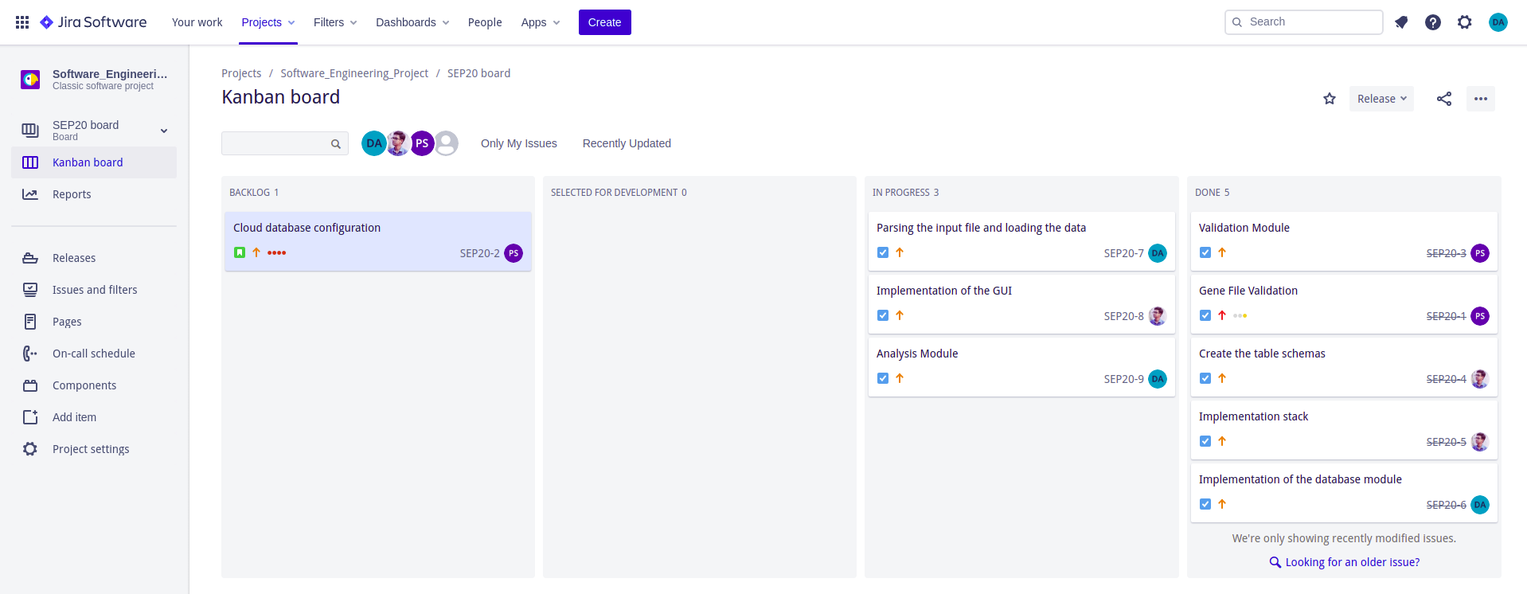
Case Study :
We used the atlassian JIRA software for the development of our lab assignment on Gene Sequencing and Analysis.
Fig : Screenshot of our Dashboard (Kanban board).
<number>

Slide 11










Worldwide Usage Stats:
Used by more than 65K + companies
Used by teams from sizes 2 to 2000
Used in a variety of Industries:
Software
Professional Services
Media & Communication
Education
Healthcare
<number>

Slide 12
THANK YOU!!
<number>

